Slide 1
Decision Tree
Dr.K DeviPriya
Associate Professor
CSE ,LBRCE

Slide 2
Decision Tree ID3
The ID3 algorithm builds decision trees using a top-down greedy search approach through the space of possible branches with no backtracking.
A greedy algorithm, as the name suggests, always makes the choice that seems to be the best at that moment.

Slide 3
Steps of ID3 Algorithms:
1. Select Root node(S) based on low Entropy and Highest Information Gain
2 . On each iteration of an algorithms it calculate the Entropy and Information gain, considering that every node is unused
3. Select node base on Highest I.G
4. then Splits set S to produce the subsets of data
5. An algorithms continuous to recur on each subset and make sure that attributes are fresh and Creates the decision Tree.

Slide 4
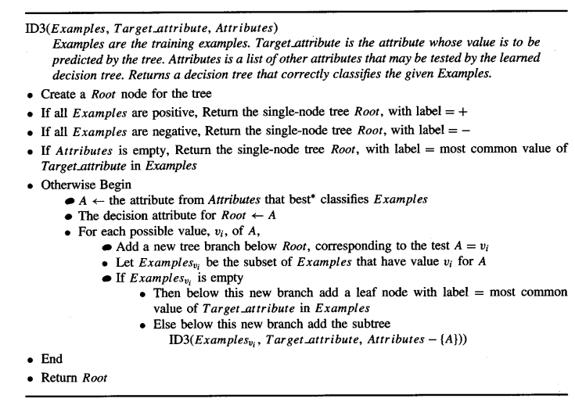
Decision Tree ID3-Algorithm

Slide 5
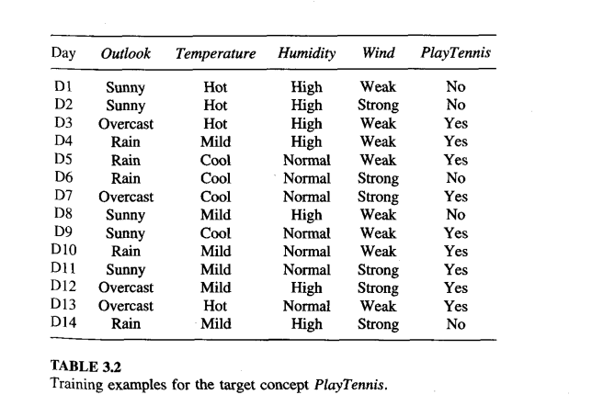
Decision Tree ID3 –Data Set

Slide 6
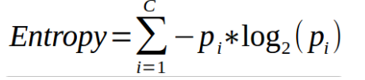

Before going deep in the algorithms understand some Statistical Terms Involves in it:
1. Entropy :
A decision tree is built top-down from a root node and involves partitioning the data into subsets that contain instances with similar values (homogeneous). ID3 algorithm uses entropy to calculate the homogeneity of a sample.
if Entropy E(s) = 0 means it is Completely homogenic or we can say that it is Leaf node of tree so it can't be divided further and ID3 uses Lowest Entropy to splitting the algorithm.

Slide 7
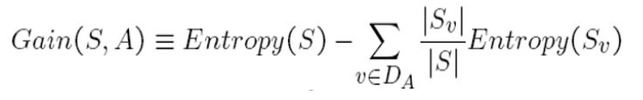
2 . Information Gain:
The information gain is based on the decrease in entropy after a data-set is split on an attribute. Constructing a decision tree is all about finding attribute that returns the highest information gain (i.e., the most homogeneous branches)

Slide 8
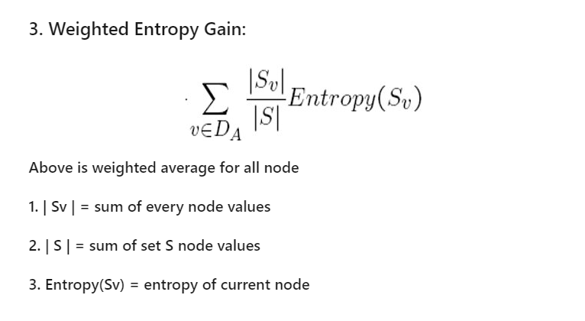
Weighted Entropy Gain

Slide 9
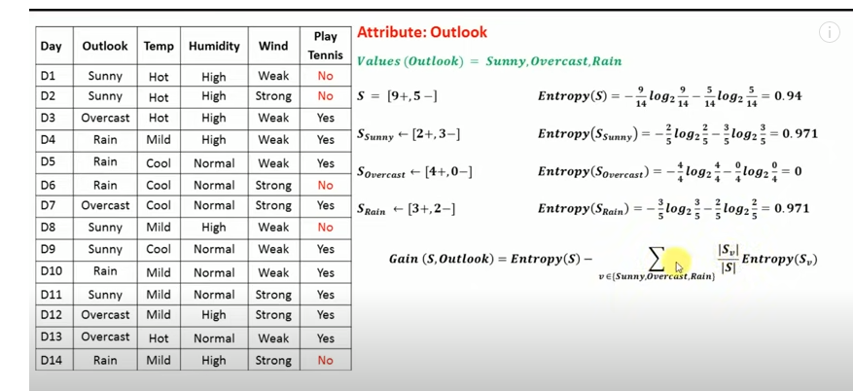
Information Gain for Outlook

Slide 10
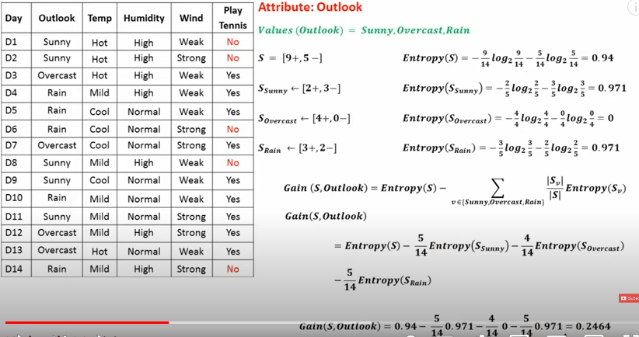
Information Gain for Outlook

Slide 11
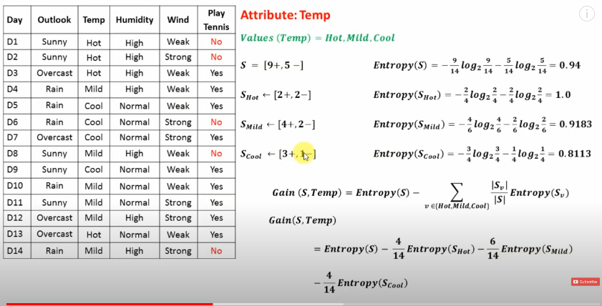
Information Gain for Temp

Slide 12
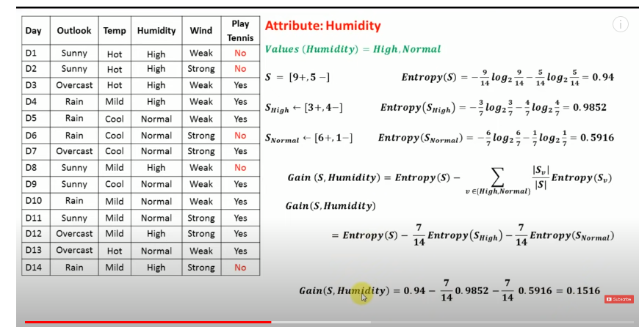
Information Gain for Humidity

Slide 13
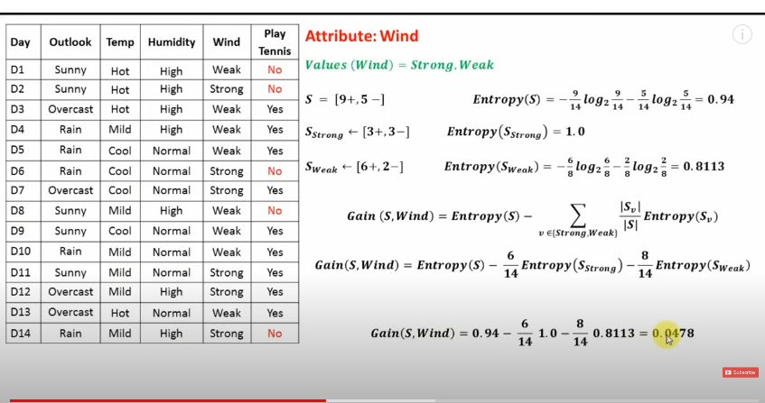
Information Gain for Wind

Slide 14
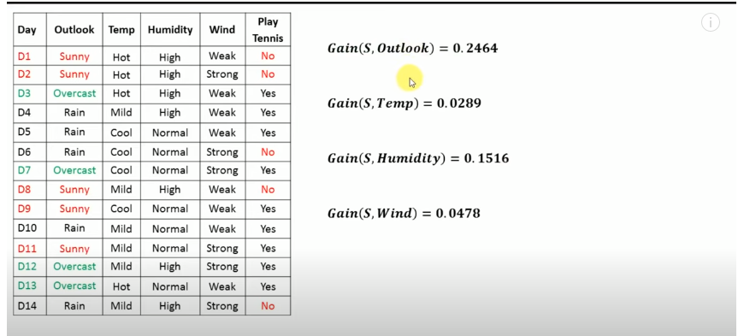
Information Gain for all attributes under Set(Target)

Slide 15
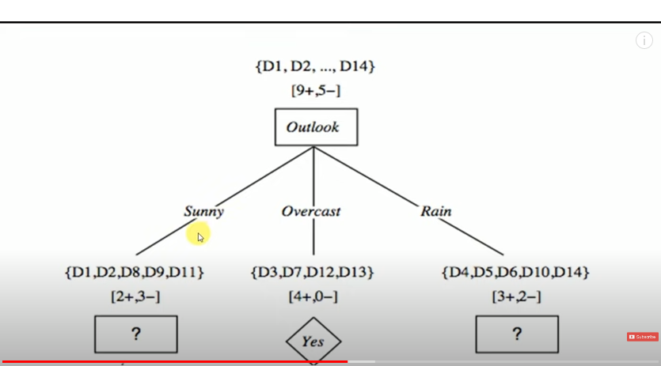
Highest Information Gain is Outlook and all overcast values gives target as Yes,and remaining values sunny,rain need to calculate subnode

Slide 16
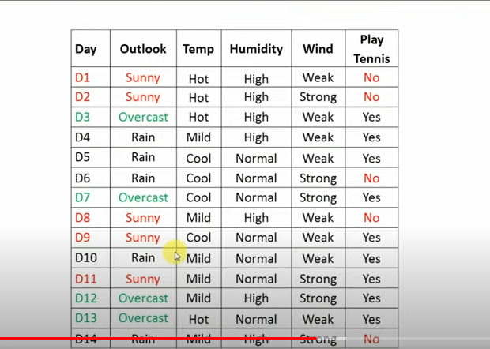
Find the sub table for outlook with sunny value(D1,D2,D8,D9,D11)

Slide 17
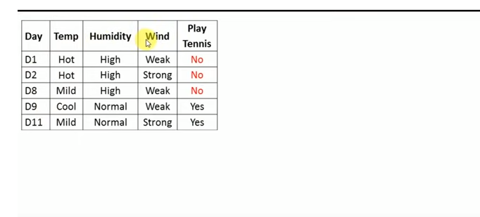
Sunny Sub Set-D1,D2,D8,D9,D11

Slide 18
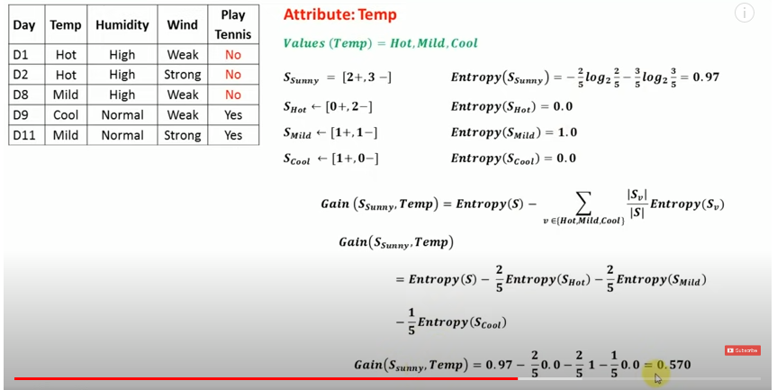
Information Gain for Temp-Under Sunny value

Slide 19
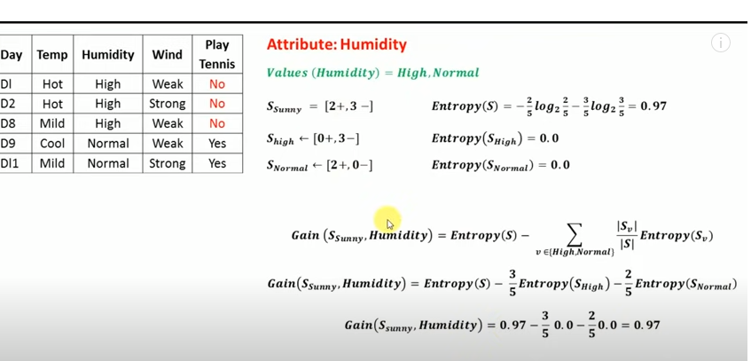
Information Gain for Humidity-Under Sunny value

Slide 20
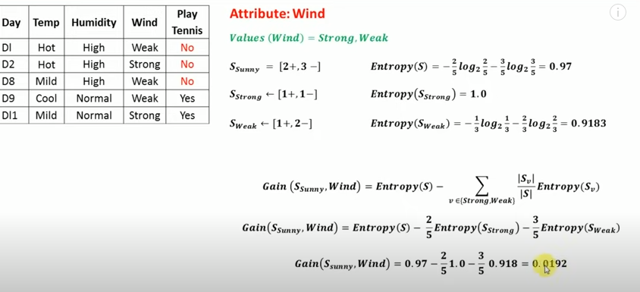
Information Gain for Wind-Under Sunny value

Slide 21
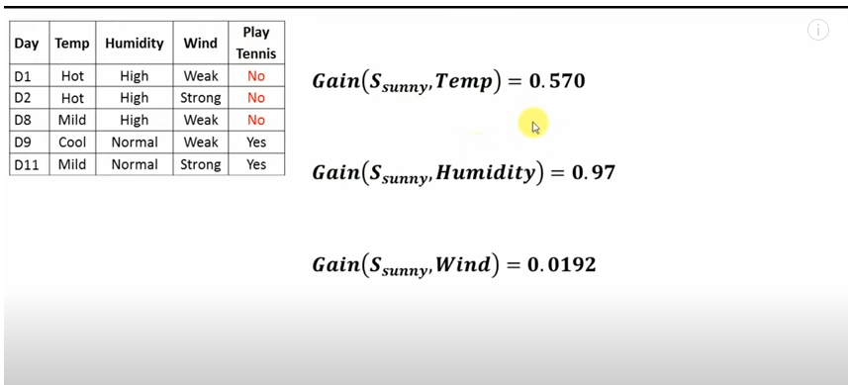
Highest Information Gain is Humidity

Slide 22
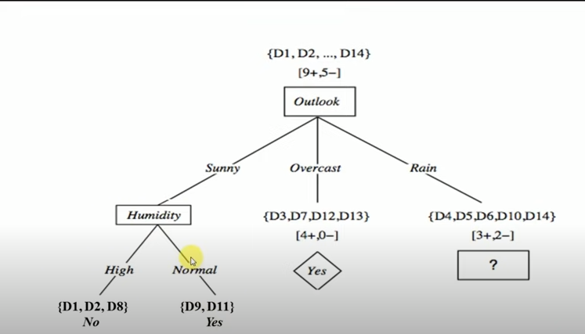
Humidity is next child node with High and normal and all high with sunny combination is No and normal combination is yes

Slide 23
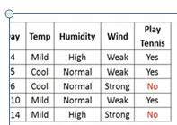
Rain Sub Set-D4,D5,D6,D10,D14

Slide 24
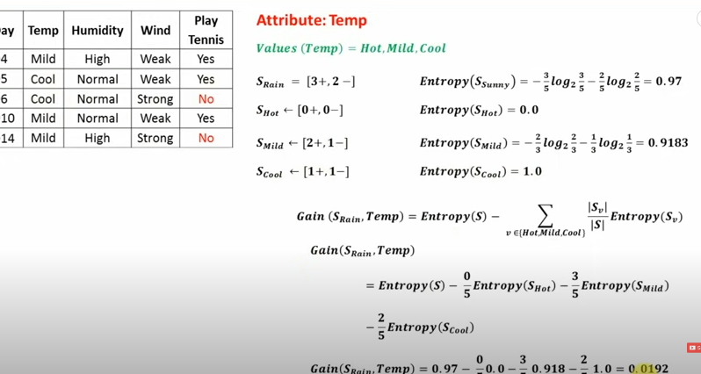
Information Gain for Temp-Under Rain value

Slide 25
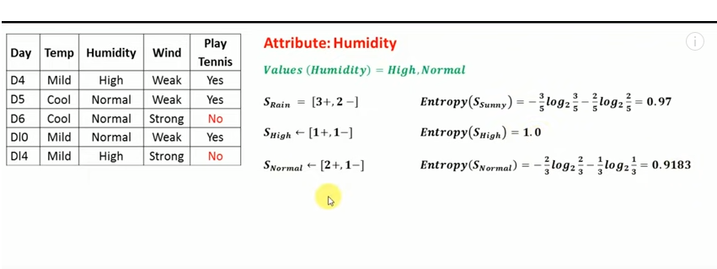
Information Gain for Humidity-Under Rain value

Slide 26
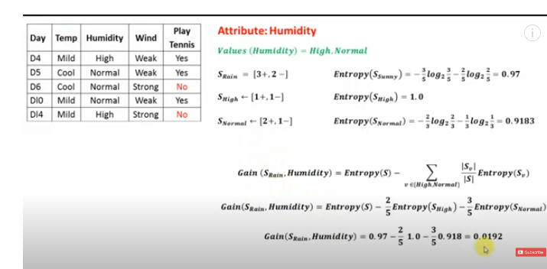
Information Gain for Humidity-Under Rain value

Slide 27
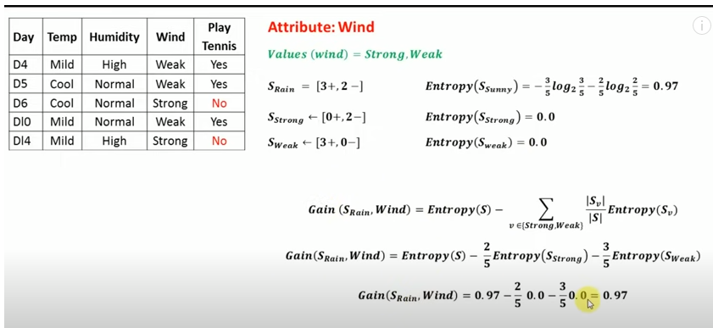
Information Gain for Wind-Under Rain value

Slide 28
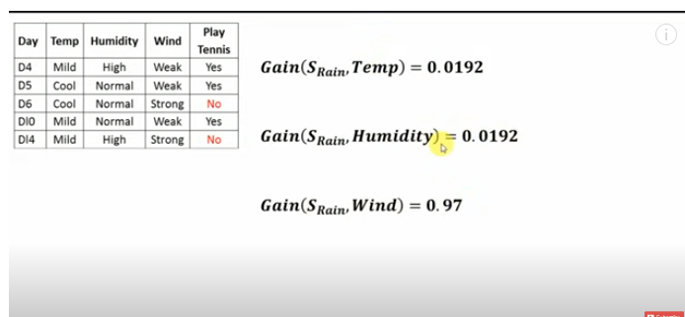
Highest Information Gain is Wind

Slide 29
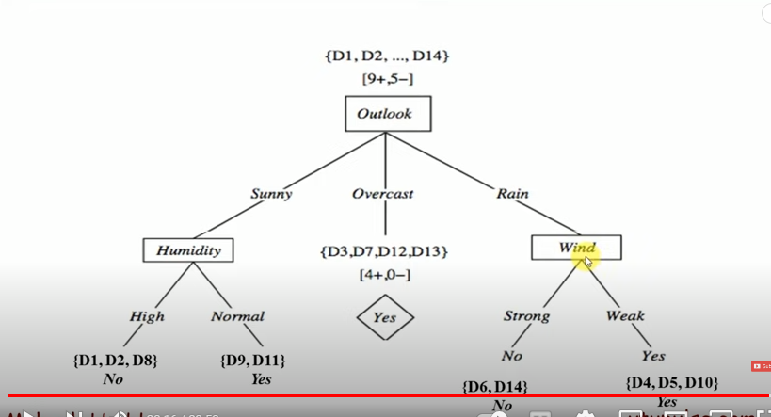
Wind is next child node with Strong and weak and all Strong with Rain combination is No and weak combination is yes

Slide 30
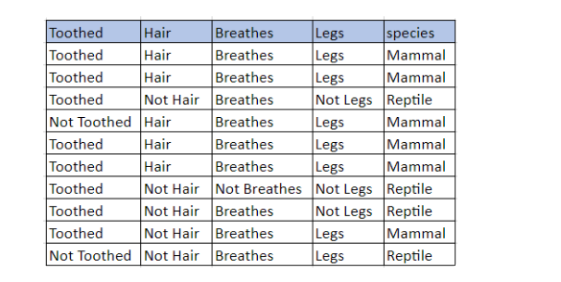
Assignment

Slide 31
Assignment
Construct Decision Tree for the given dataset using ID3 and analyze the evaluation parameters(Acuuracy,precision,recall etc.,)
Step by step procedure required for the selection of best attributes

Slide 32
References
https://www.youtube.com/watch?v=coOTEc-0OGw
“Machine Learning” by Tom M. Mitchell

